Slide 1





MALTAomics Summer School
Introduction to Genomic Data Science
Panagiotis Alexiou
ERA Chair,
Bioinformatics for Genomics in Malta
(BioGeMT)

Slide 2
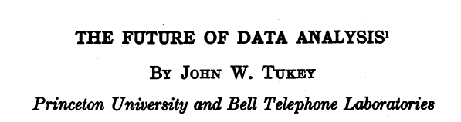
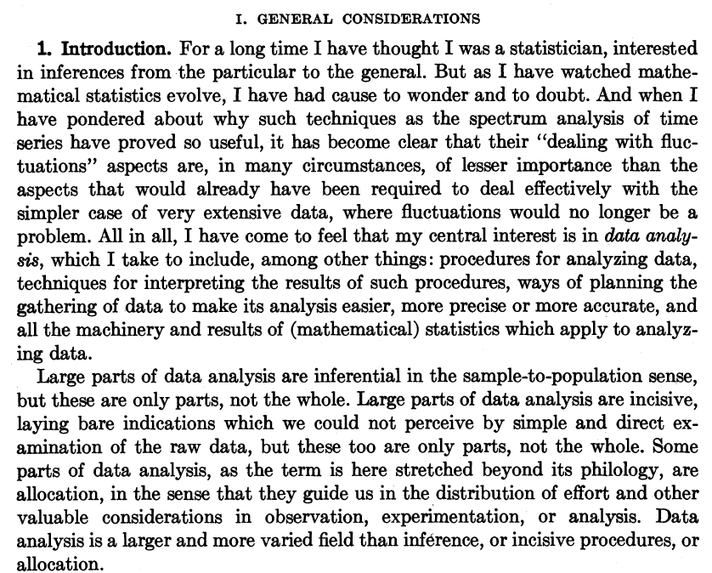
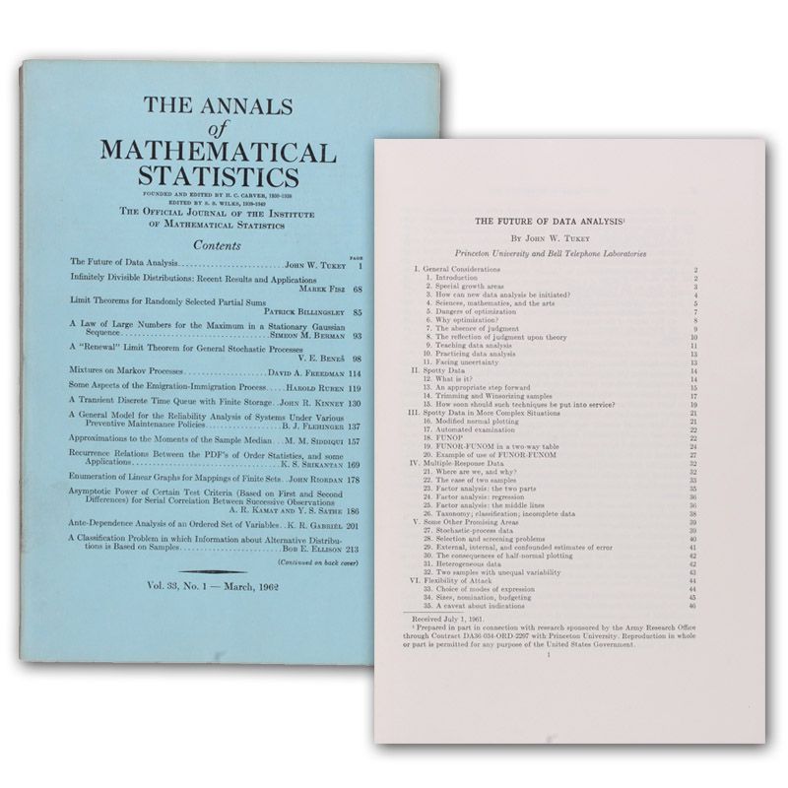
1962
https://projecteuclid.org/journals/annals-of-mathematical-statistics/volume-33/issue-1/The-Future-of-Data-Analysis/10.1214/aoms/1177704711.full

Slide 3
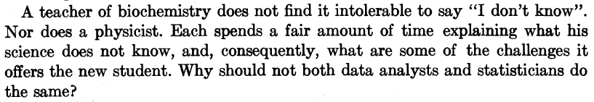
1962
https://projecteuclid.org/journals/annals-of-mathematical-statistics/volume-33/issue-1/The-Future-of-Data-Analysis/10.1214/aoms/1177704711.full

Slide 4

Data Science is an interdisciplinary academic field that uses statistics, scientific computing, scientific methods, processes, algorithms and systems to extract or extrapolate knowledge and insights from noisy, structured, and unstructured data.

Slide 5
Exploring the Intersection of two Revolutionary Fields
Data Science is an interdisciplinary academic field that uses statistics, scientific computing, scientific methods, processes, algorithms and systems to extract or extrapolate knowledge and insights from noisy, structured, and unstructured data.
Genomics emerged in the 1980s as the confluence of genetics, statistics, and large-scale datasets. This pre-eminent role of genomics also inspired the emergence of many “-omics” terms inside and outside academia.
Genomics

Slide 6
Exploring the Intersection of two Revolutionary Fields
Data Science is an interdisciplinary academic field that uses statistics, scientific computing, scientific methods, processes, algorithms and systems to extract or extrapolate knowledge and insights from noisy, structured, and unstructured data.
Genomics Data Science is an interdisciplinary academic field that uses statistics, scientific computing, scientific methods, processes, algorithms and systems to extract or extrapolate knowledge and insights from noisy, structured, and unstructured genomic data.
Genomics emerged in the 1980s as the confluence of genetics, statistics, and large-scale datasets. This pre-eminent role of genomics also inspired the emergence of many “-omics” terms inside and outside academia.
Genomics

Slide 7
Exploring the Intersection of many (?) Revolutionary Fields
-omics Data Science is an interdisciplinary academic field that uses statistics, scientific computing, scientific methods, processes, algorithms and systems to extract or extrapolate knowledge and insights from noisy, structured, and unstructured -omic data.
Genomics
Transcriptomics
Proteomics
Metabolomics
Epi-(omics)
Phenomics
…
-omics
-omics
Methods common in the analysis of various –omics data and their combination (multi-omics)

Slide 8
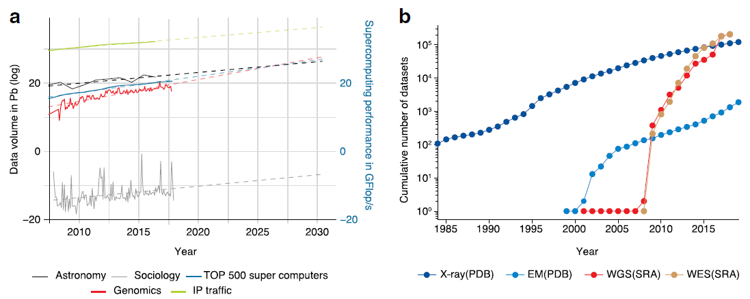
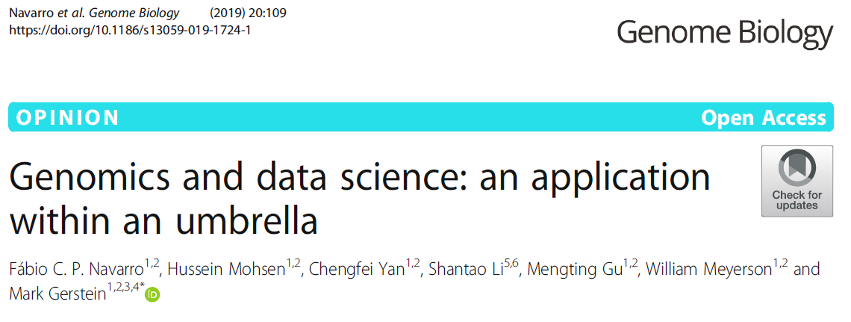
V framework of Data
Volume
Velocity
Variety

Slide 9
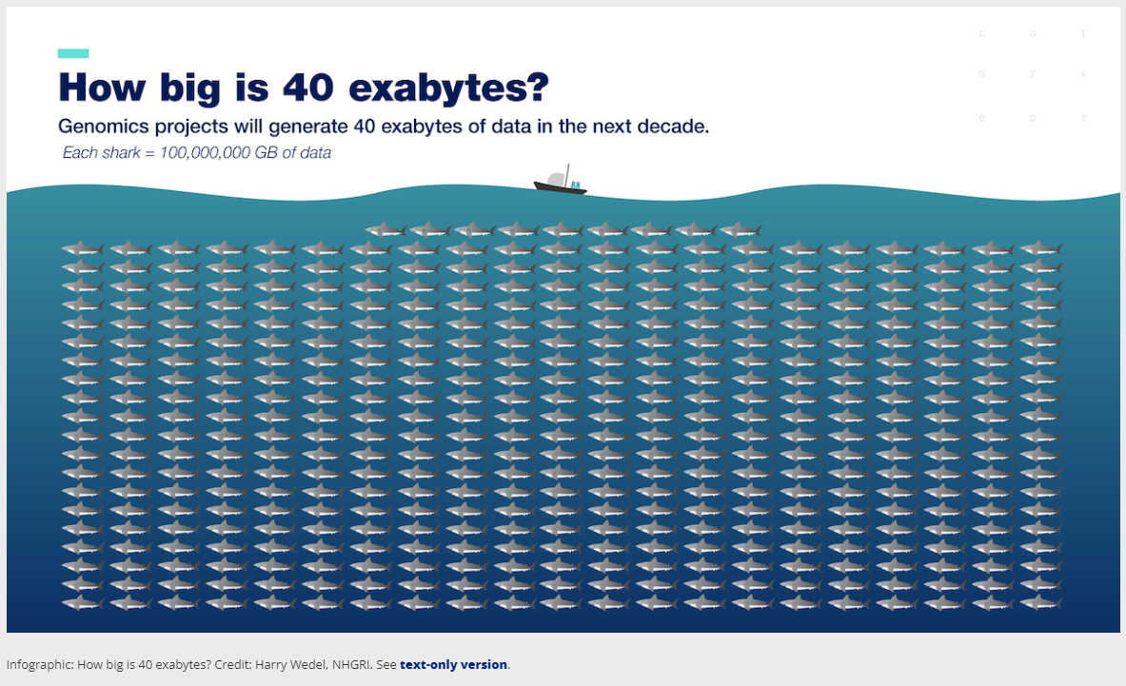

Slide 10
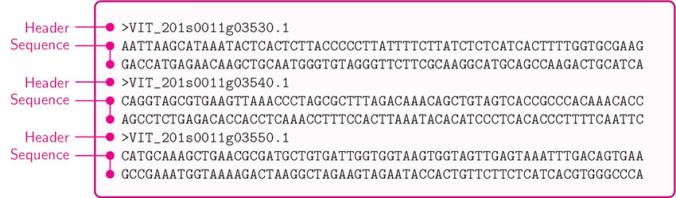
How does –omics Data look like?
Genomic / Transcriptomic
Sequences

Slide 11
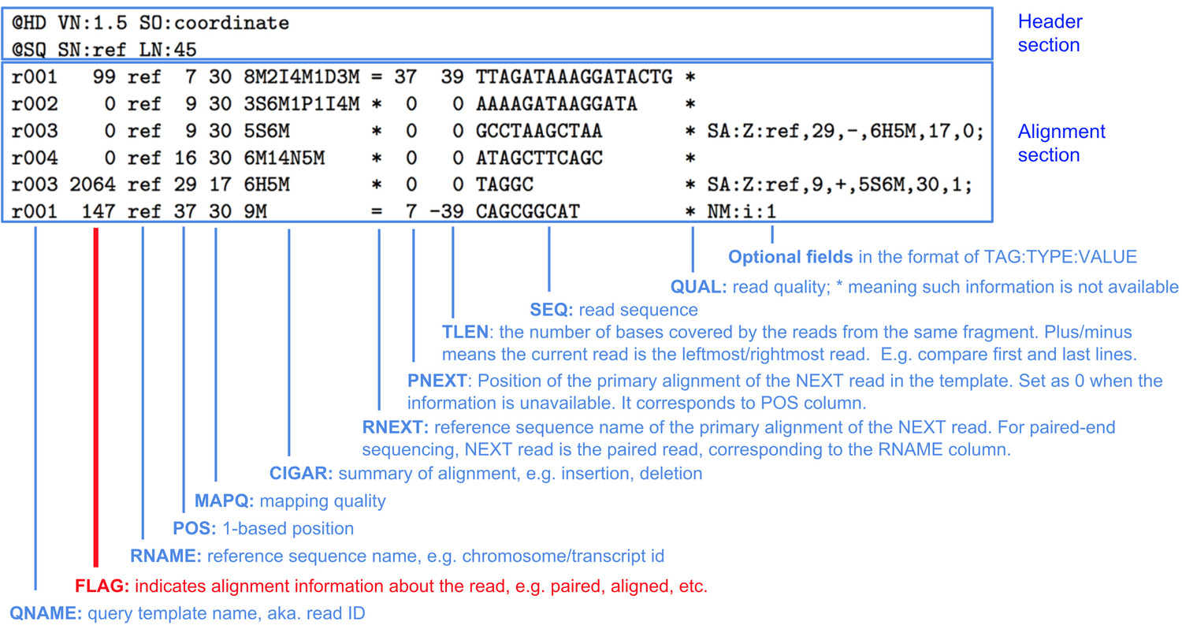
How does –omics Data look like?
Sequence
Alignment
Map
(.sam)

Slide 12

How does –omics Data look like?

Slide 13
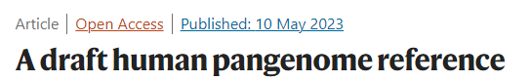
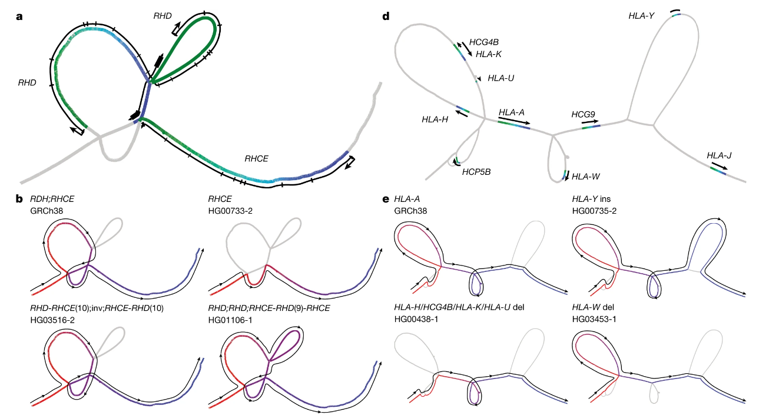
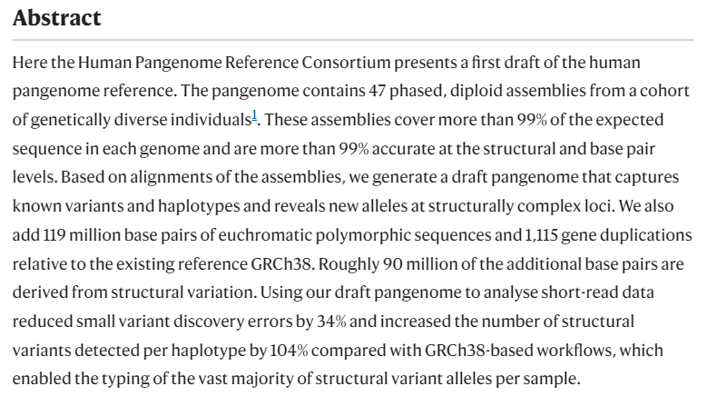
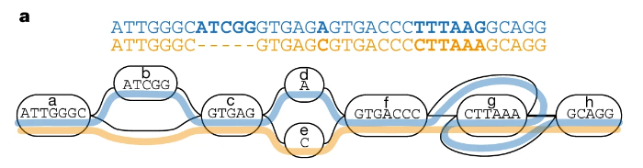
https://www.nature.com/articles/s41586-023-05896-x

Slide 14
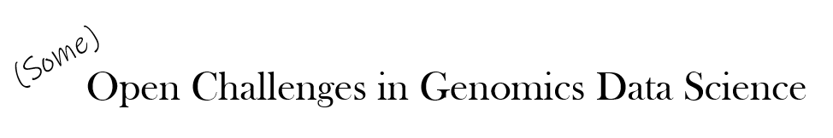
(Some)
Open Challenges in Genomics Data Science

Slide 15
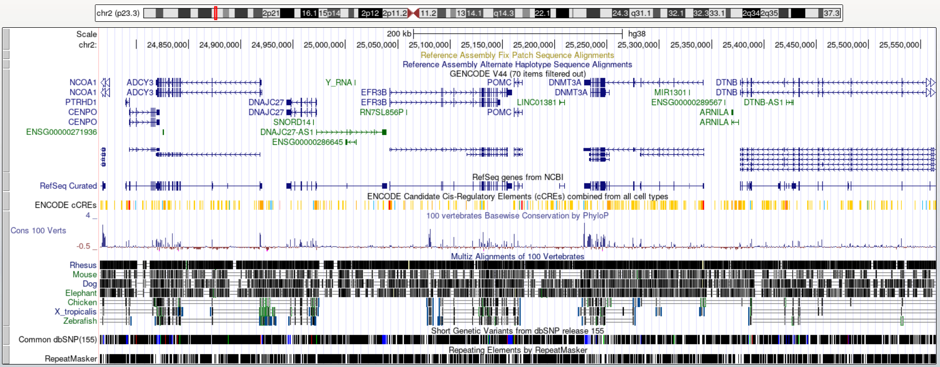
Genomic Annotation
Methods based on evolutionary conservation, sequence patterns, aggregation of experimental results, and others.
Machine Learning methods increasingly used for this purpose.

Slide 16
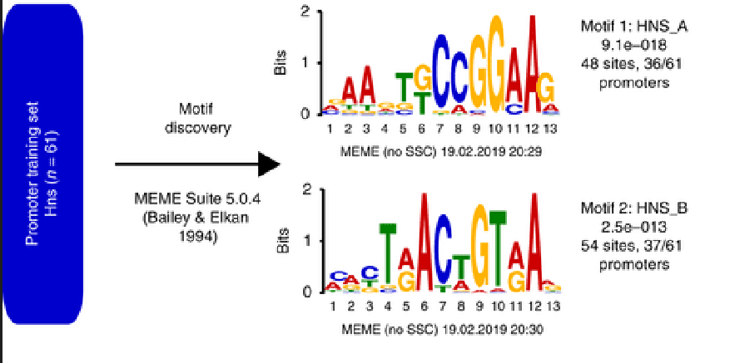
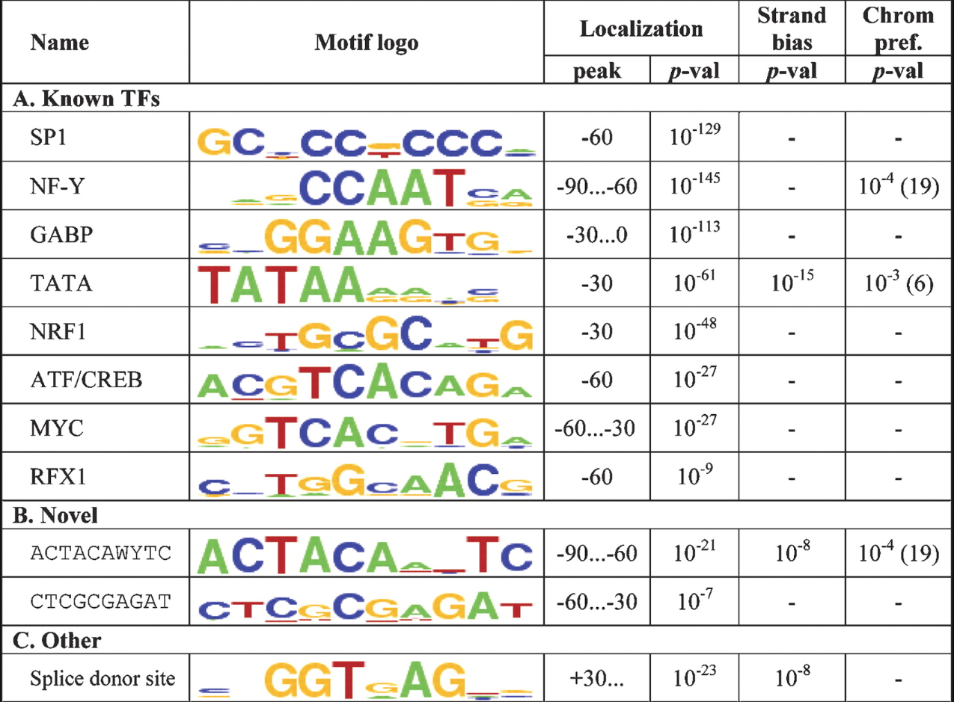
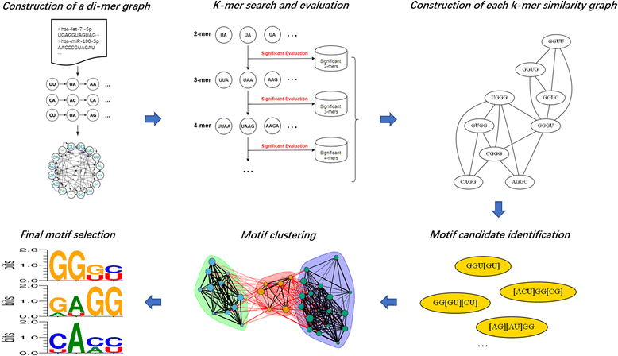
Regulatory Motif Discovery

Slide 17
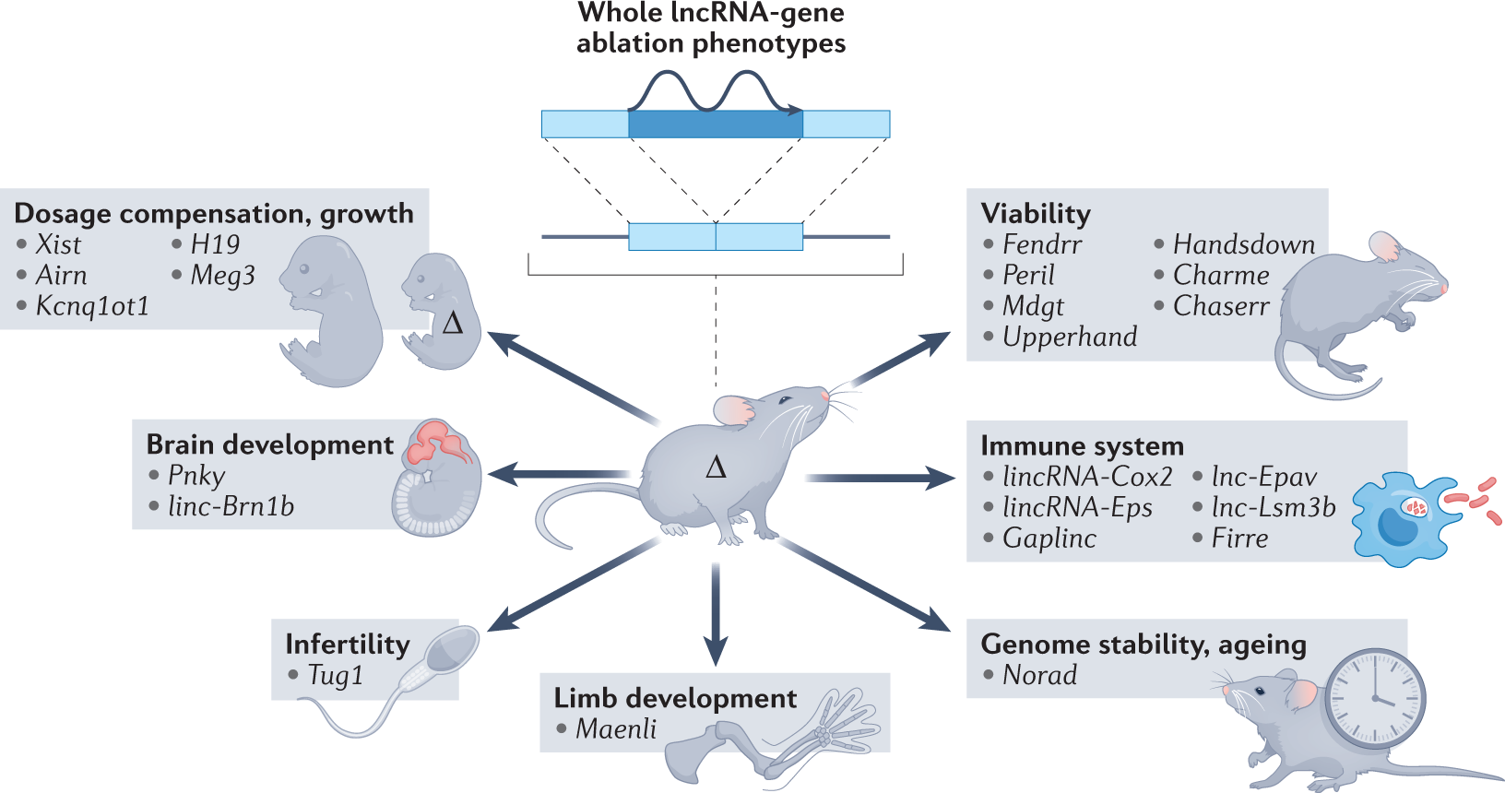
Long non-coding RNAs
Is the ‘language’ of lncRNAs based on sequence, shape, or something else?
What is the ‘syntax’ of this language?

Slide 18
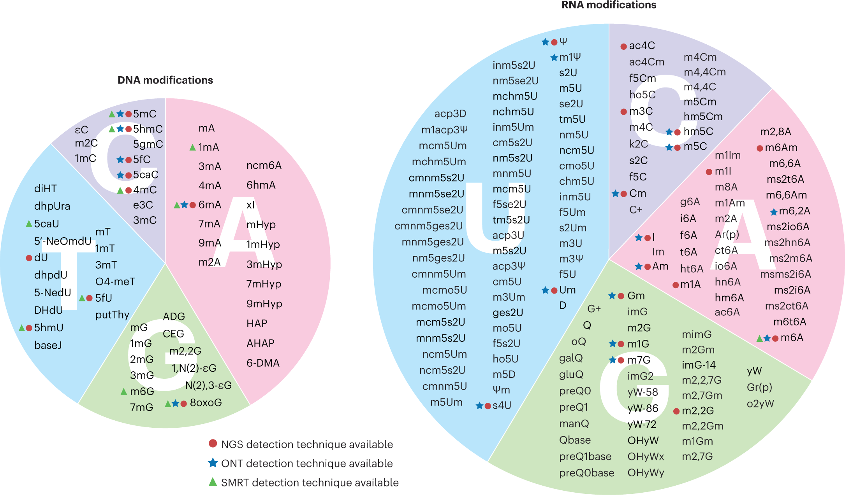
Epigenomics and Epitranscriptomics

Slide 19
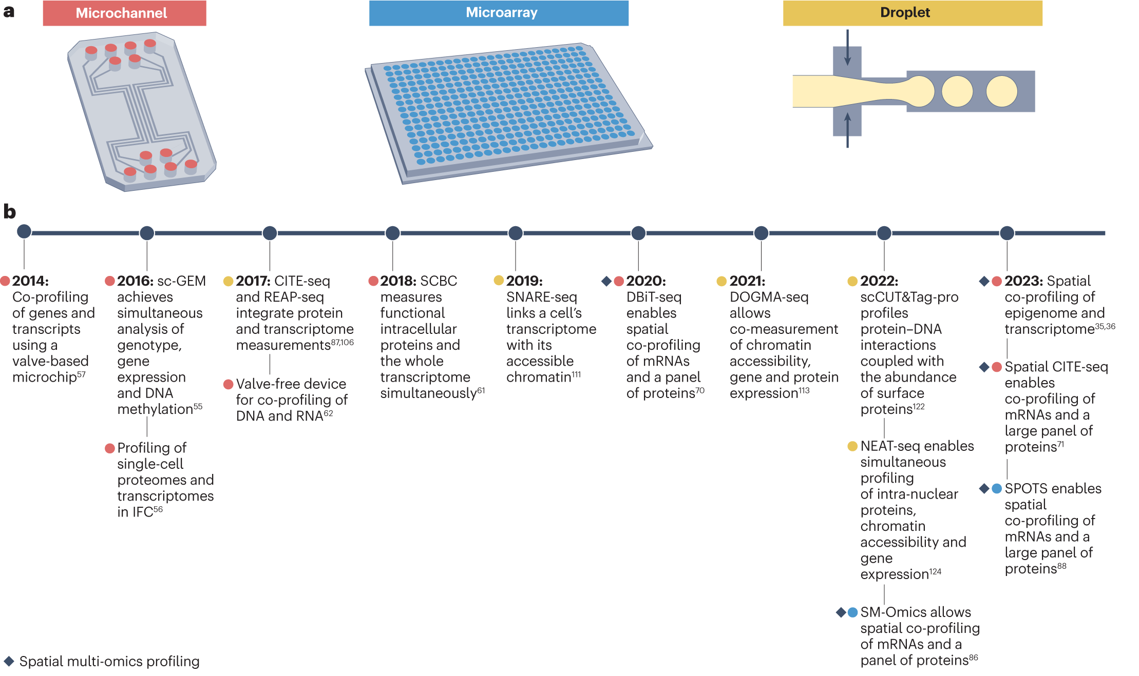
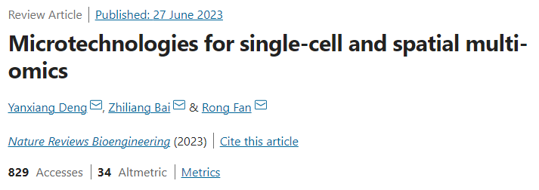

Spatial multi-omics in single cells

Slide 20
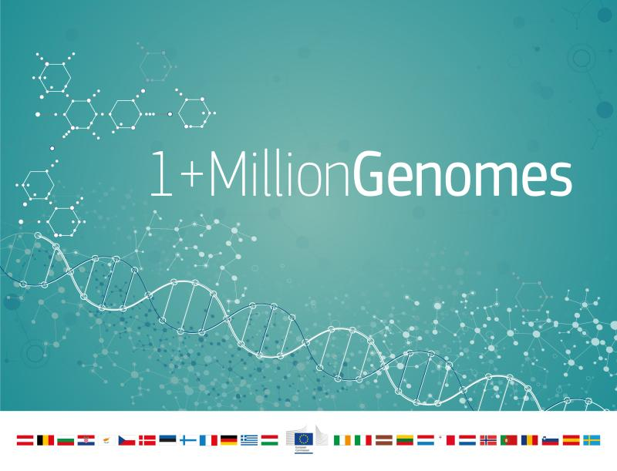
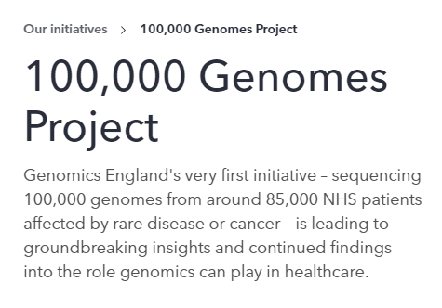


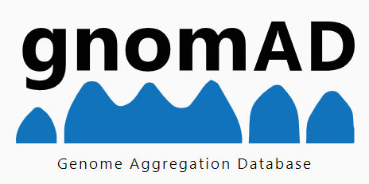

Genome Sequencing at Population Scale

Slide 21
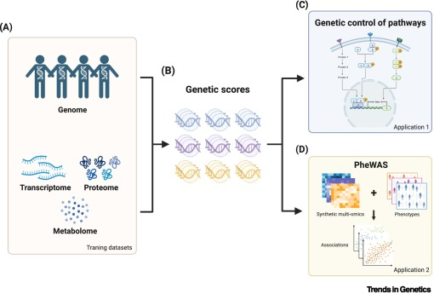
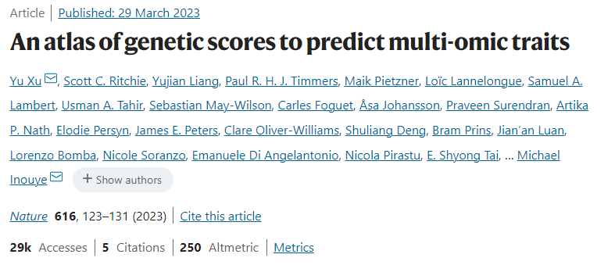
Understanding multifactorial traits / diseases

Slide 22
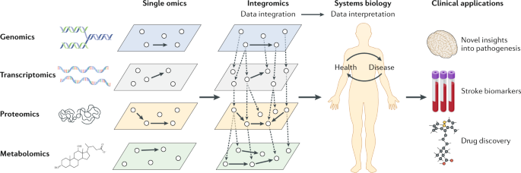
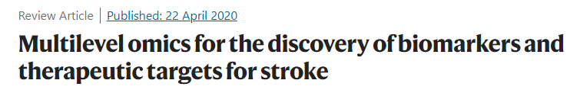
-omics and Medicine

Slide 23
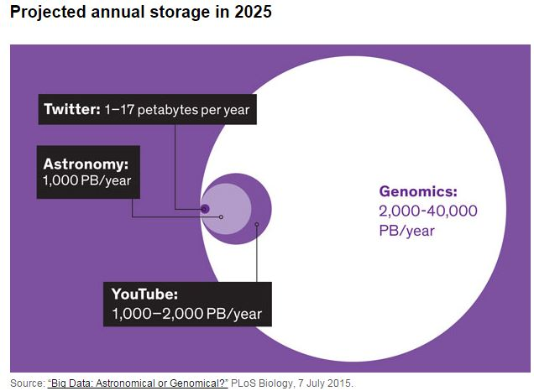

Slide 24

Computational
Power and
Storage
Scientific
Findings
Exabytes of
Genomic Data
Trained and
Efficient
Bioinformaticians
(-omic Data Scientists)

